Slide 1
Basic of Color Theory

Slide 2
Understanding Color
Color is all around us.
It is a sensation that adds excitement and emotion to our lives.
Everything from the cloths we wear, to the pictures we paint revolves around color.
Without color; the world (especially RGB World) would be a much less beautiful place.
Color can also be used to describe emotions; we can be red hot, feeling blue, or be green with envy.
Light is made up of energy waves which are grouped together in what is called a spectrum.
Light that appears white to us, such as light from the sun, is actually composed of many colors.
The wavelengths of light are not colored, but produce the sensation of color.

Slide 3
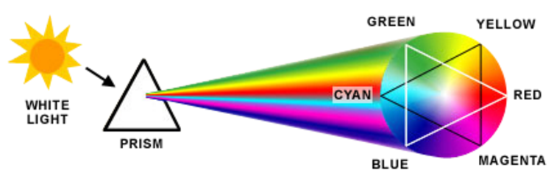
Understanding Color

Slide 4
Visible light
The wavelengths our eyes can detect is only a small portion of the electromagnetic energy spectrum which wee call the visible light spectrum.
At one end of the visible spectrum are the short wavelengths of light we perceive as blue.
At the other end of the visible spectrum are the longer wavelengths of light we perceive as red.
All the other colors we can see in nature are found somewhere along the spectrum between blue and red.
Beyond the limits at each end of the visible spectrum are the short wavelengths of ultraviolet light and Xrays and the long wavelengths of infrared radiation and radio waves, which are not visible to the human eye.

Slide 5

Primary Color
If the visible portion of the light spectrum is divided into thirds, the predominant colors are red, green and blue.
These three colors are considered the primary colors of the visible light spectrum.
Primary colors can be arranged in a circle, commonly referred to as a color wheel.
Red, green and blue (RGB) form a triangle on the color wheel.
In between the primary colors are the secondary colors, cyan, magenta and yellow (CMY), which form another triangle.

Slide 6
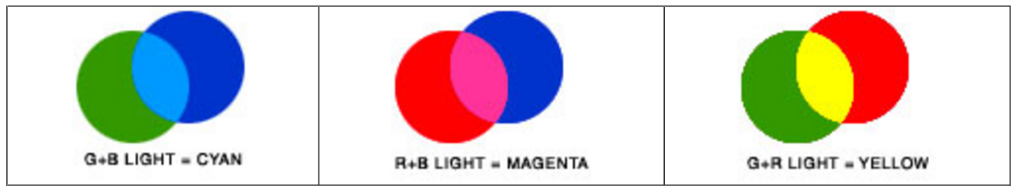
Additive Color System (RGB)
The additive color system involves light emitted directly from a source, before an object reflects the light.
The additive reproduction process mixes various amounts of red, green and blue light to produce other colors.
Combining one of these additive primary colors with another produces the additive secondary colors cyan, magenta, yellow.
Combining all three primary colors produces white.
Television and computer monitors create color using the primary colors of light.
Each pixel on a monitor screen starts out as black.
When the red, green and blue phosphors of a pixel are illuminated simultaneously, that pixel becomes white. This phenomenon is called additive color.

Slide 7
Subtractive Color System (CMY)
Photographs, magazines and other objects of nature such as an apple; create color by subtracting or absorbing certain wavelengths of color while reflecting other wavelengths back to the viewer. This phenomenon is called subtractive color.
The subtractive color system involves colorants and reflected light.
Subtractive color starts with an object (often a substrate such as paper or canvas) that reflects light and uses colorants (such as pigments or dyes) to subtract portions of the white light illuminating an object to produce other colors.
If an object reflects all the white light back to the viewer, it appears white. If an object absorbs (subtracts) all the light illuminating it, no light is reflected back to the viewer and it appears black. It is the subtractive process that allows everyday objects around us to show color.

Slide 8

Cont..
Color paintings, color photography and all color printing processes use the subtractive process to reproduce color. In these cases, the reflective substrate is canvas (paintings) or paper (photographs, prints), which is usually white.
Printing presses use color inks that act as filters and subtract portions of the white light striking the image on paper to produce other colors.
Printing inks are transparent, which allows light to pass through to and reflect off of the paper base.
It is the paper that reflects any unabsorbed light back to the viewer.

Slide 9
Cont..
The offset printing process uses cyan, magenta and yellow (CMY) process color inks and a fourth ink, black.
The black printing ink is designated K to avoid confusion with B for blue.
Overprinting one transparent printing ink with another produces the subtractive secondary colors, red, green, blue.
To be reproducible on press, an original color image, such as a photograph, must first be converted into a pattern of small dots for each of the four colors (CMYK).
When printed with ink on paper, the small dots fool the eye and give the visual appearance of the original Image.

Slide 10
Munsell color system
The Munsell color system is a color space that specifies colors based on three color dimensions: hue, value (lightness), and chroma (color purity).
It was created by Professor Albert H. Munsell in the first decade of the 20th century.
The system consists of three independent dimensions which can be represented cylindrically in three dimensions as an irregular color solid:
hue, measured by degrees around horizontal circles;
chroma, measured radially outward from the neutral (gray) vertical axis; and
value, measured vertically from 0 (black) to 10 (white).
Munsell determined the spacing of colors along these dimensions by taking measurements of human visual responses.

Slide 11
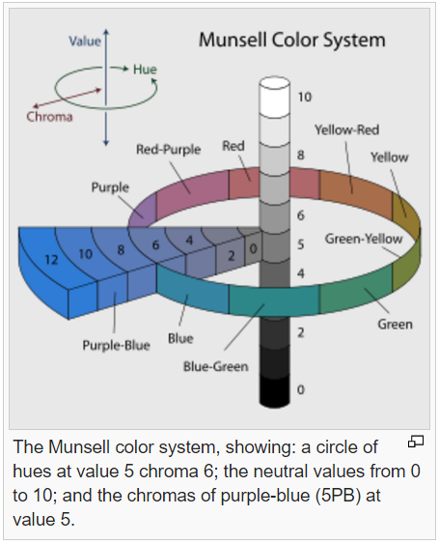
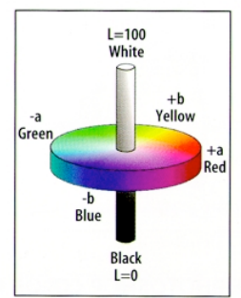
In each dimension, Munsell colors are as close to perceptually uniform as he could make them, which makes the resulting shape quite irregular.

Slide 12
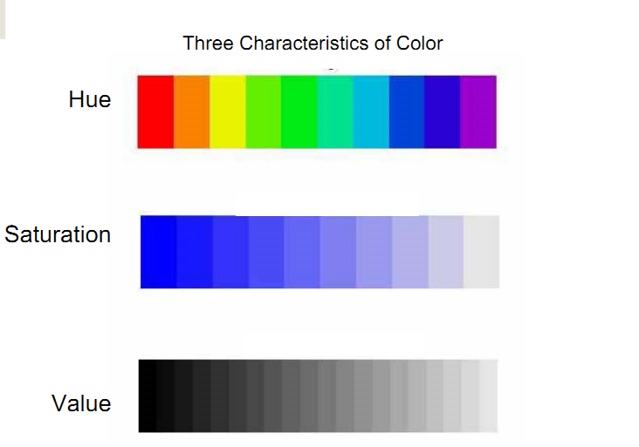
Color dimension
The perception of color is often described by referring to three dimensions of the color experiences: hue, saturation, and brightness.

Slide 13
Hue
Refers to the color quality of the light and corresponds to the color names that we use, such as orange, purple, green, indigo, yellow, cyan, etc.
In fact, hue is the quality of color.
A quality is a value that changes, but it does not make the value larger or smaller.
When hue or color changes, it does not make sense to say that red has more or less hue than green.
This is because color is a quality, not an amount.

Slide 14
Saturation
Refers to the purity of the light.
The more saturated the stimulus, the stronger the color experience, and the less saturated, the more it appears white or gray or black—that is, achromatic.
The classic example of saturation differences concerns the continuum from red to pink.
Pink is a combination of red light and white light.
The more white light is added, the less “red” the pink is.
Eventually, the red may be so overwhelmed by the white that we barely notice the pink at all.

Slide 15
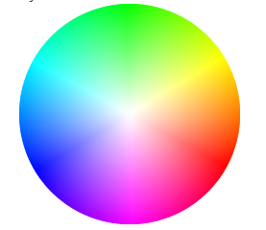
Hue and saturation can be represented as a color circle below.
Along the perimeter of the circle, we find the monochromatic hues—red, orange, yellow, green, blue, indigo, and violet.
As we head toward the center of the circle, we get less and less saturated colors.
Thus, a deep red and a deep blue exist on the perimeter, but pink and baby blue exist toward the center.

Slide 16
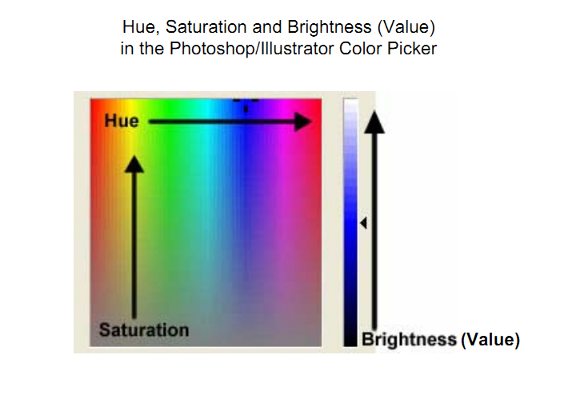
Brightness (Value)
Refers to the amount of light present.
The more bright an object is, the easier it is to see and to notice the colors.
Brightness is the dimension that now goes vertically through the color circle.
Brightness does have a relation to color—it is easier to see color at higher brightness values.

Slide 17
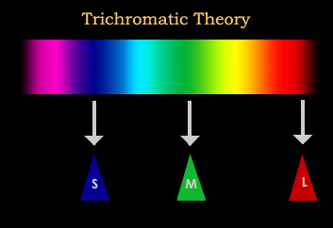
Theories of Color Perception
Trichromatic Theory
According to the trichromatic theory of color vision, also known as the Young-Helmholtz theory of color vision, there are three receptors in the retina that are responsible for the perception of color.
One receptor is sensitive to the color green, another to the color blue and a third to the color red. These three colors can then be combined to form any visible color in the spectrum.

Slide 18
The theory began when Thomas Young proposed that color vision results from the actions of three different receptors.
As early as 1802, Young suggested that the eye contained different photoreceptor cells that were sensitive to different wavelengths of light in the visible spectrum.
It was later in the mid-1800s that researcher Hermann von Helmholtz expanded upon Young's original theory and suggested that the cone receptors of the eye were either short-wavelength (blue), medium-wavelength (green) or long-wavelength (red).
He also proposed that it was the strength of the signals detected by the receptor cells that determined how the brain interpreted color in the environment.
Helmholtz discovered that people with normal color vision need three wavelengths of light to create different colors through a series of experiments.

Slide 19
The opponent Process Theory
The opponent-process theory of color vision suggests that our ability to perceive color is controlled by three receptor complexes with opposing actions.
These three receptors complexes are the red-green complex, the blue-yellow complex and the black-white complex.
According to the opponent-process theory, these cells can only detect the presence of one color at a time because the two colors oppose one another.
We do not see greenish-red because the opponent cells can only detect one of these colors at a time.
The opponent color process works through a process of excitatory and inhibitory responses, with the two components of each mechanism opposing each other.
For example, red creates a positive (or excitatory) response while green creates a negative (or inhibitory) response.
These responses are controlled by opponent neurons, which are neurons that have an excitatory response to some wavelengths and an inhibitory response to wavelengths in the opponent part of the spectrum.

Slide 20
Color Constancy
Is the ability to perceive colors of objects, invariant to the color of the light source.
Color constancy refers to the observation that we see the same color despite changes in the composition of the wavelengths of light that is striking that object.
Thus, a green mug appears to be the same color regardless of whether the light illuminating it is natural sunlight, a fluorescent lightbulb, or an incandescent lightbulb.
This is true even though the object is now reflecting different absolute amounts of light at different wavelengths under each illumination condition.
Color constancy serves an important perceptual function—the properties of objects seldom change as a function of changes in the source of illumination.

Slide 21
Cont..
Thus, a system that sees an object as a constant color across such changes leads to accurate perception.
Interestingly, the distribution of wavelengths in sunlight changes across the day.
Evening light has more long wavelength light than light earlier in the day.
Although we might enjoy the colors of twilight, we do not normally see objects as changing colors, though we are aware of general changes in illumination when we attend to them.

Slide 22
Color Vision Impairment:
Trichromacy
Normal color vision uses all three types of light cones correctly and is known as trichromacy.
People with normal color vision are known as trichromats.
Anomalous Trichromacy:
People with ‘faulty’ trichromatic vision will be color blind to some extent and are known as anomalous trichromats.
In people with this condition all of their three cone types are used to perceive light colors but one type of cone perceives light slightly out of alignment, so that there are three different types of effect produced depending upon which cone type is ‘faulty’.
Three different anomalous conditions are:
Protanomaly: reduced sensitivity to red light
Deuteranomaly: reduced sensitivity to green light, most common form of color blindness.
Triatanomaly: reduced sensitivity to blue light, is
extremely rarely.

Slide 23
Cont..
The effects of anomalous trichromatic vision can range from almost normal color perception to almost total absence of perception of the ‘faulty’ color.
People with deuteranomaly and protanomaly are collectively known as red-green color blind and they generally have difficulty distinguishing between reds, greens, browns and oranges.
People with reduced blue sensitivity have difficulty identifying differences between blue and yellow, violet and red and blue and green.
To these people the world appears as generally red, pink, black, white, grey.

Slide 24
Dichromacy
People with dichromatic color vision have only two types of cones which are able to perceive color i.e. they have a total absence of function of one cone type.
Lack of ability to see color is the easiest way to explain dichromatic condition but in actual fact it is a specific section of the light spectrum which can’t be perceived.
Different dichromatic conditions:
Protanopia: unable to perceive any red light.
Deuteranopia: unable to perceive green light.
Tritanopia: unable to perceive blue light

Slide 25
Monochromacy:
People with monochromatic vision can see no colour at all and their world consists of different shades of grey ranging from black to white, rather like only seeing the world on an old black and white television set.

Slide 26
Color management system (CMS)
The challenge of color publishing is to reproduce colors the eye sees on a series of devices that have progressively diminishing color capabilities.
Even the best photographic film can capture only a small portion of the colors discernible to the human eye.
A computer monitor can display only a small fraction of those colors, and a printing press can reproduce fewer colors still.
A color management system (CMS) is a collection of software tools designed to reconcile the different color capabilities of scanners, monitors, printers, imagesetters, and printing presses to ensure consistent color throughout the print production process.
Ideally, this means that the colors displayed on your monitor accurately represent the colors of the final output.

Slide 27
Cont..
It also means that different applications, monitors, and operating systems will display colors consistently.
A CMS is most beneficial when designing publications for output devices with small color gamuts, such as printing presses, proofers, and desktop printers.
A CMS maps colors from a device with a large color gamut, such as a monitor, to a device with a smaller color gamut, such as a proofer or printing press; consequently, all colors on the monitor represent colors that the output device can reproduce.

Slide 28
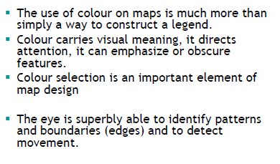
Colour use in map

Slide 29
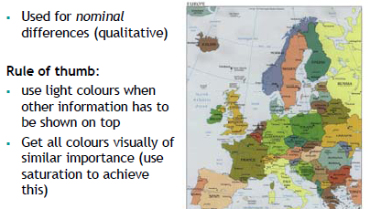
Colour use in map………….Hue/colour

Slide 30
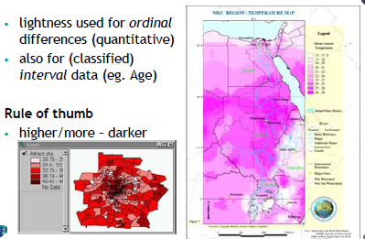
Colour use in map………….lightness

Slide 31
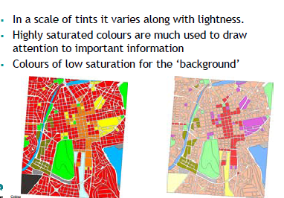
Colour use in map………….saturation

Slide 32
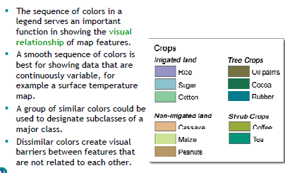
Colour use in map………….Systematic use

Slide 33
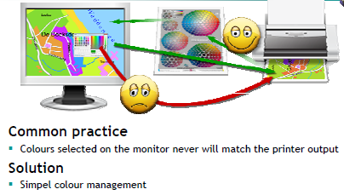
Color Charts….

Slide 34
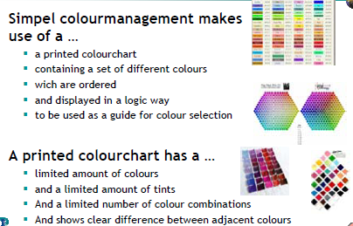
Color chart…..

Slide 35
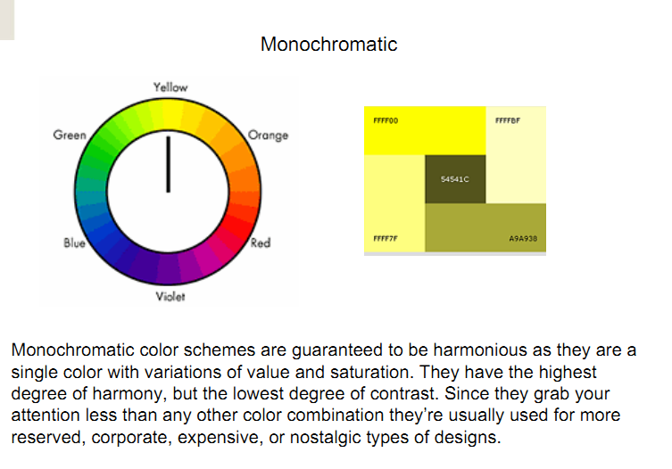
Different color schemes

Slide 36
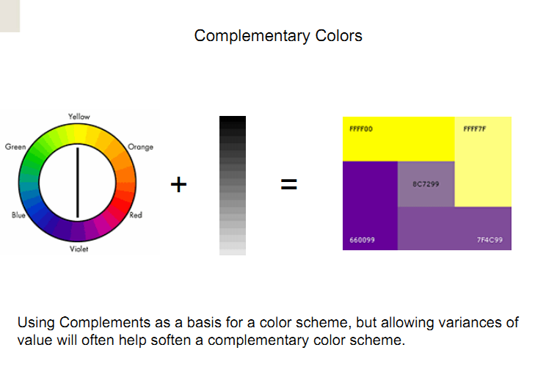

Slide 37
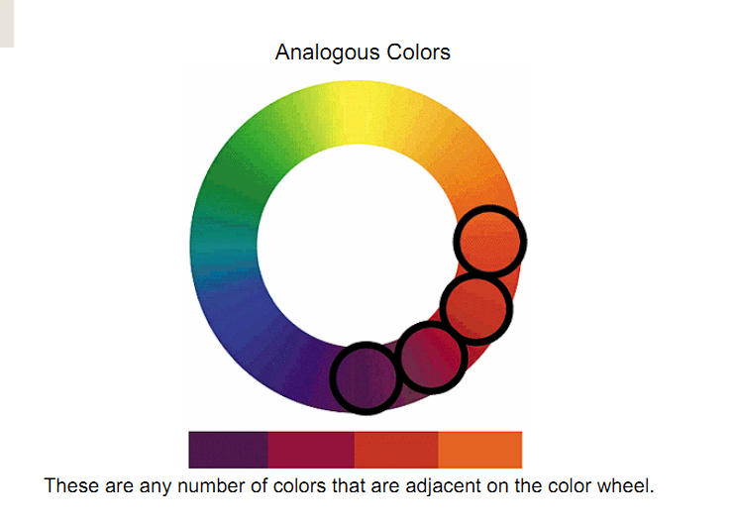

Slide 38
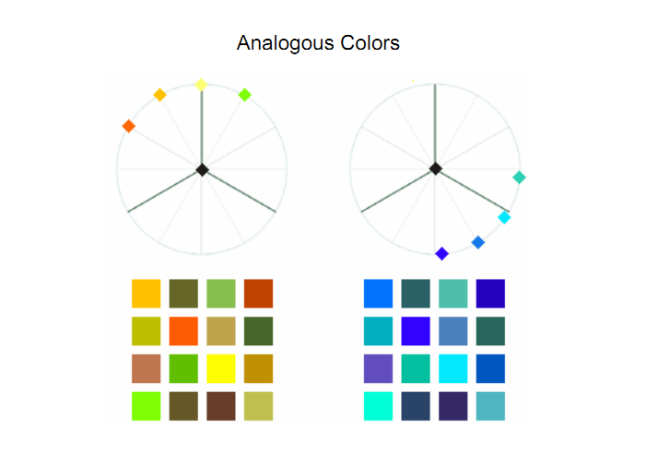

Slide 39
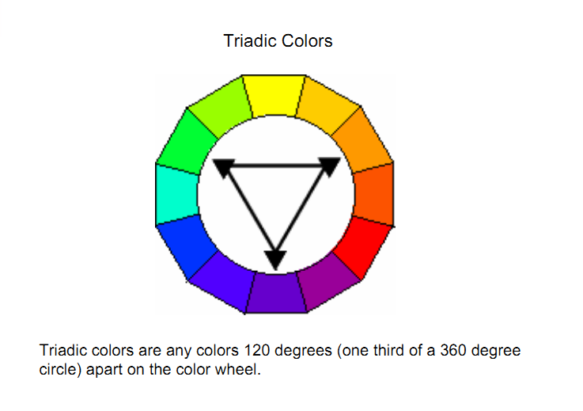

Slide 40
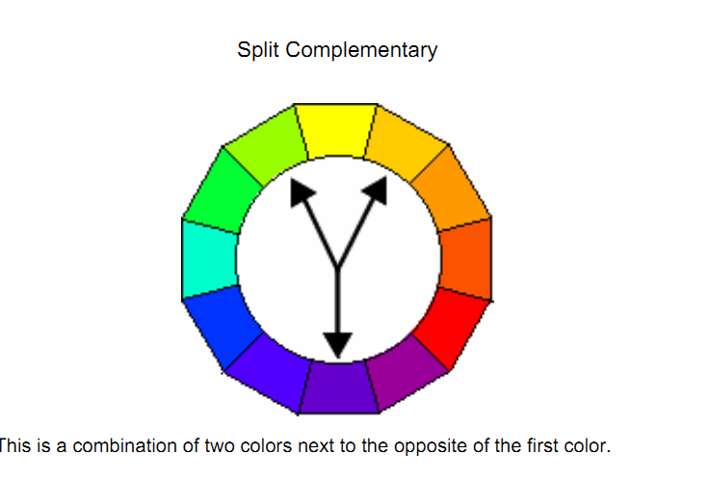

Slide 41
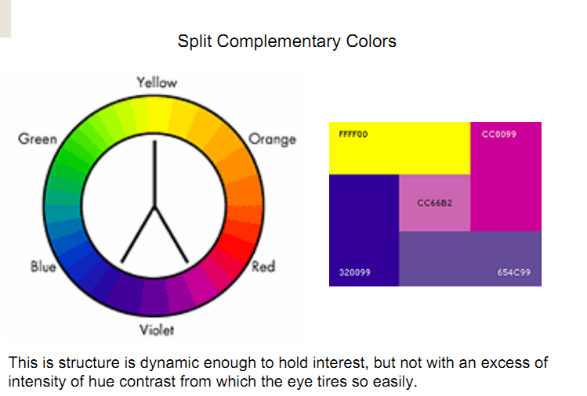

Slide 42
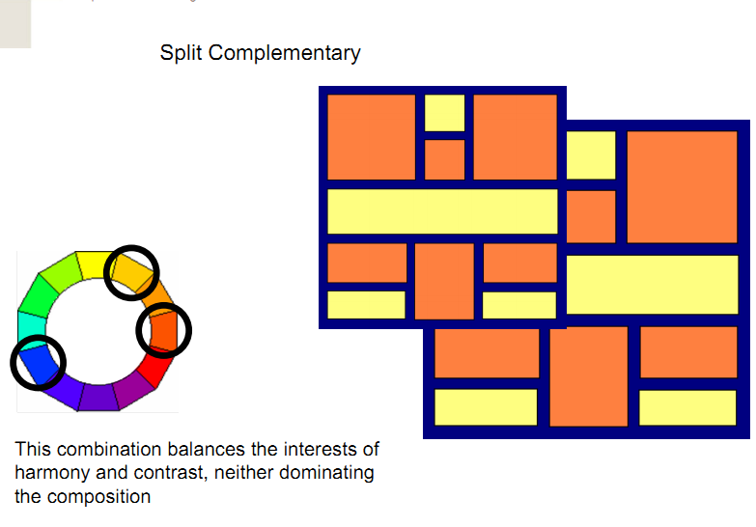

Slide 43
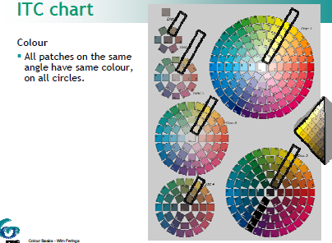

Slide 44
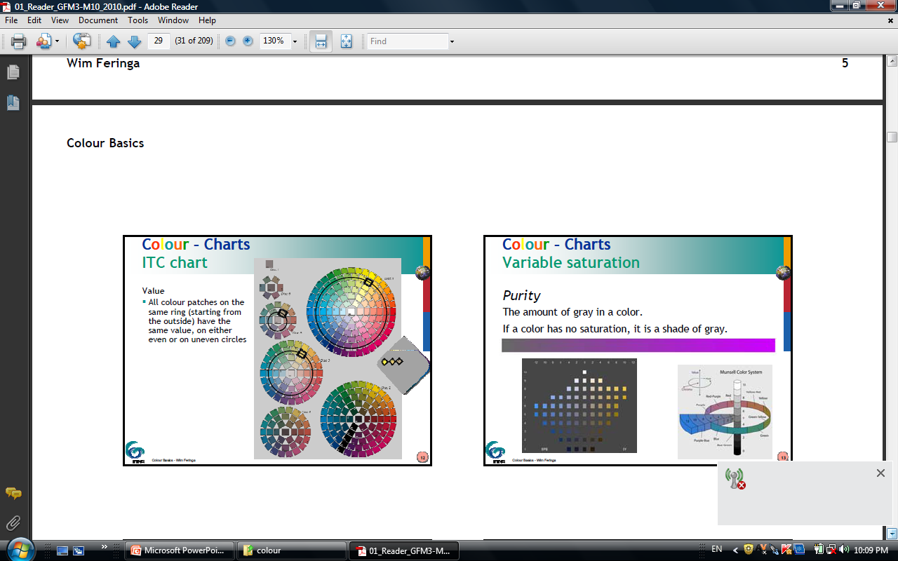
ITC chart

Slide 45
Thank You

